Slide 1
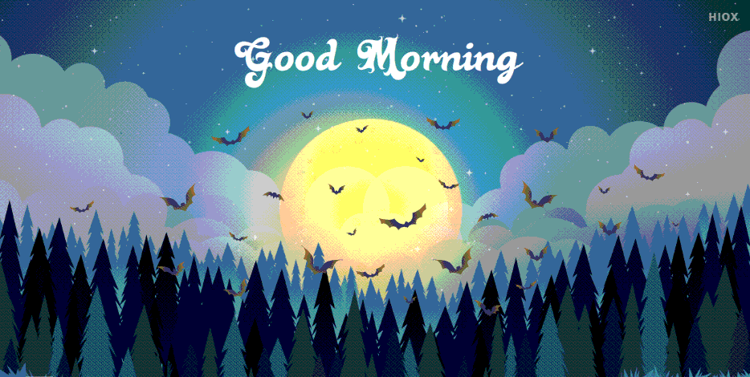

Slide 2

Starter task:
Time to talk….
If you had to describe your weekend in 3 words what would they be?

Slide 3
Essay:
Evaluate the relevance of living according to the commandments
20 marks.
Homework
Due: 31st October
(2nd Monday after the holidays.)

Slide 4
Learning Intention: Today we are finishing our thinking about the Synagogue and beginning to learn about Shabbat.
Success Criteria:
By the end of the lesson I will be able to:
. Identify and explain the importance of 3 objects connected to the synagogue.
. Explain what happens at Shabbat and why it happens.

Slide 5
Judaism
Beliefs
• beliefs about God
• nature of human beings: yetzer tov; yetzer harah; free will; suffering
• beliefs about Covenant
• judgement; the Messiah; the Messianic Age; Olam Ha’ba
Practices
• living according to the Commandments
• Rosh Hashanah; Yom Kippur
• worship: Shabbat; synagogue

Slide 6
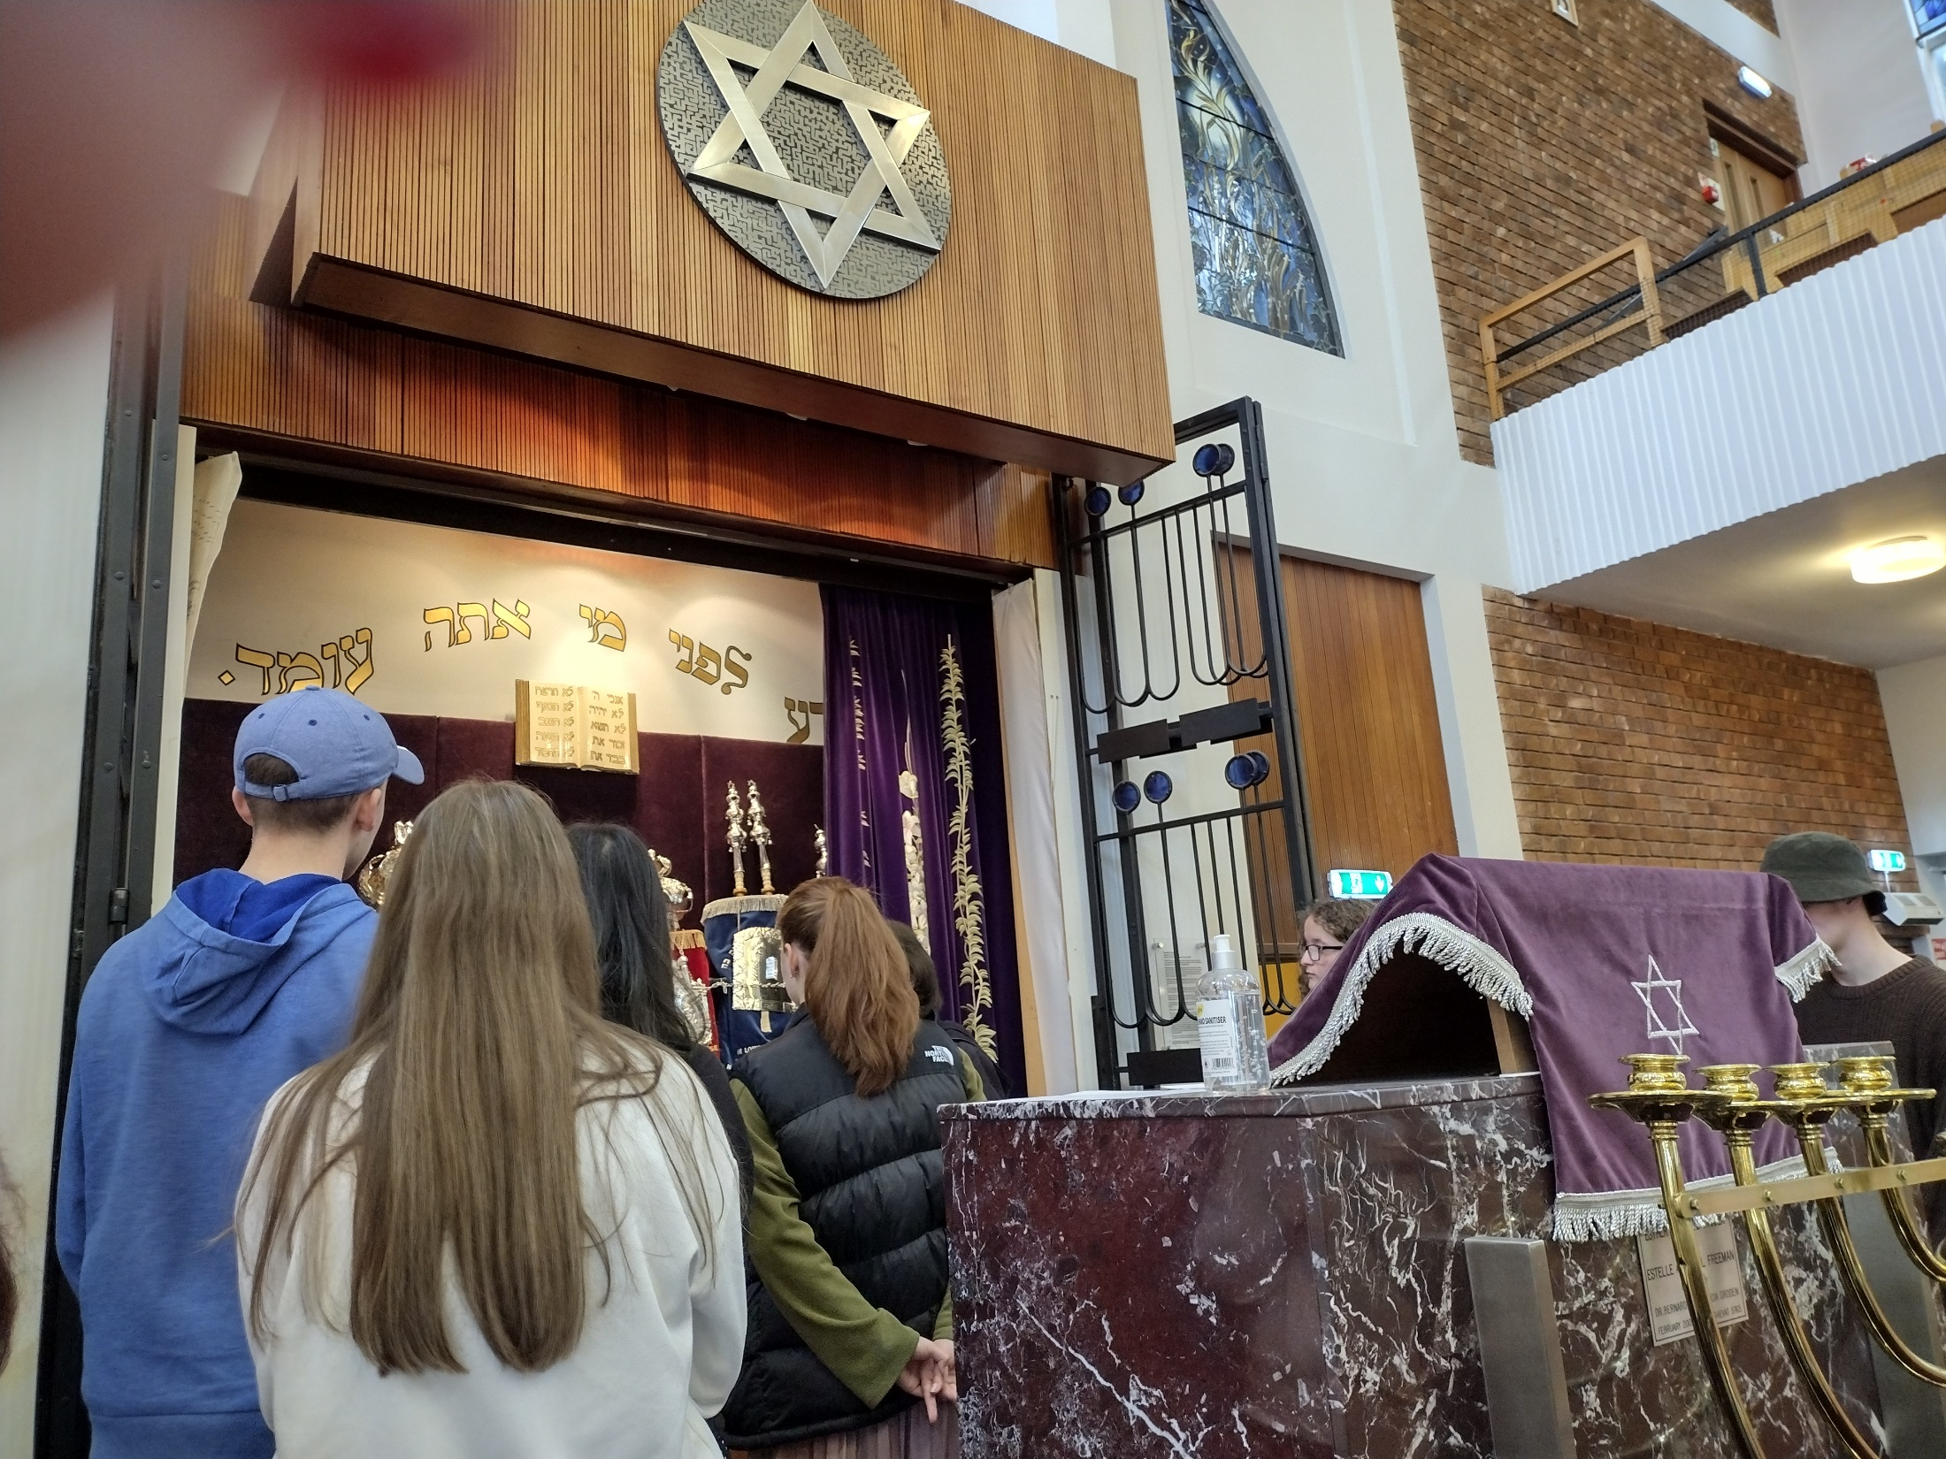

Slide 7
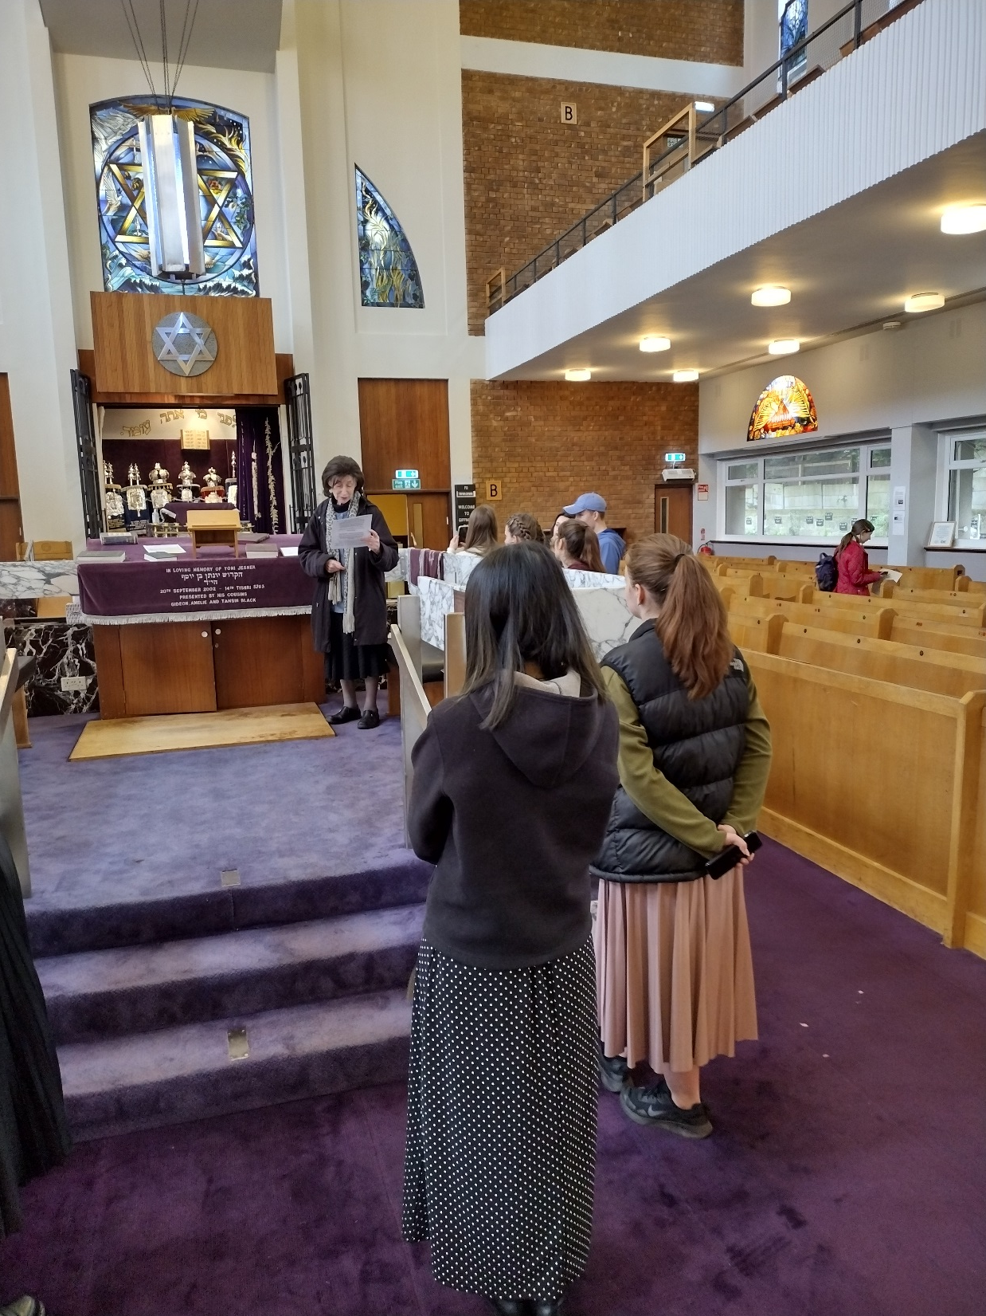
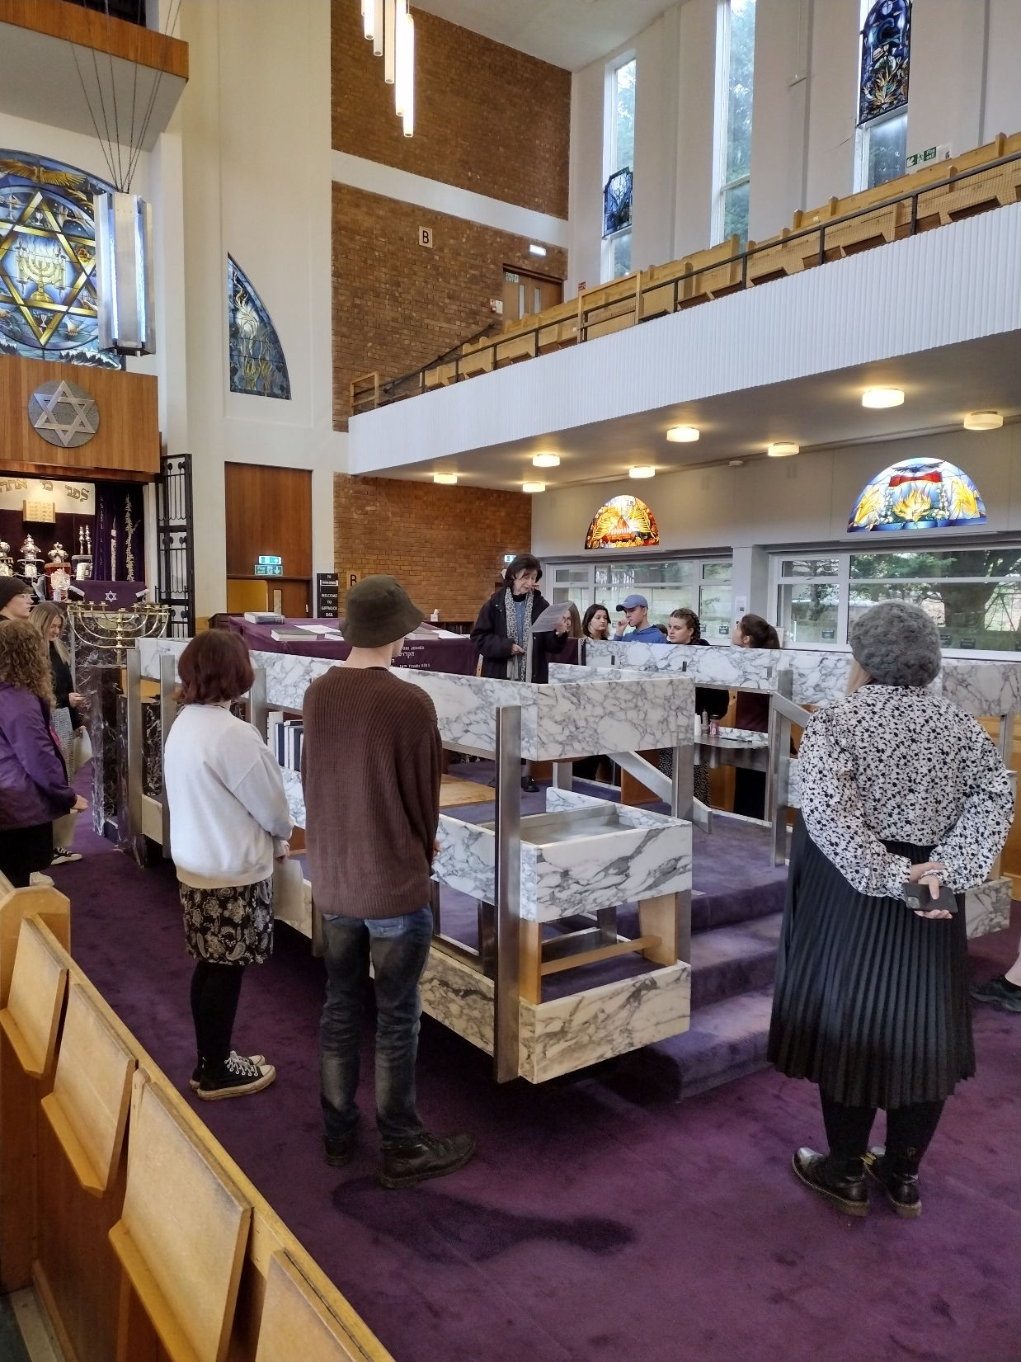

Slide 8
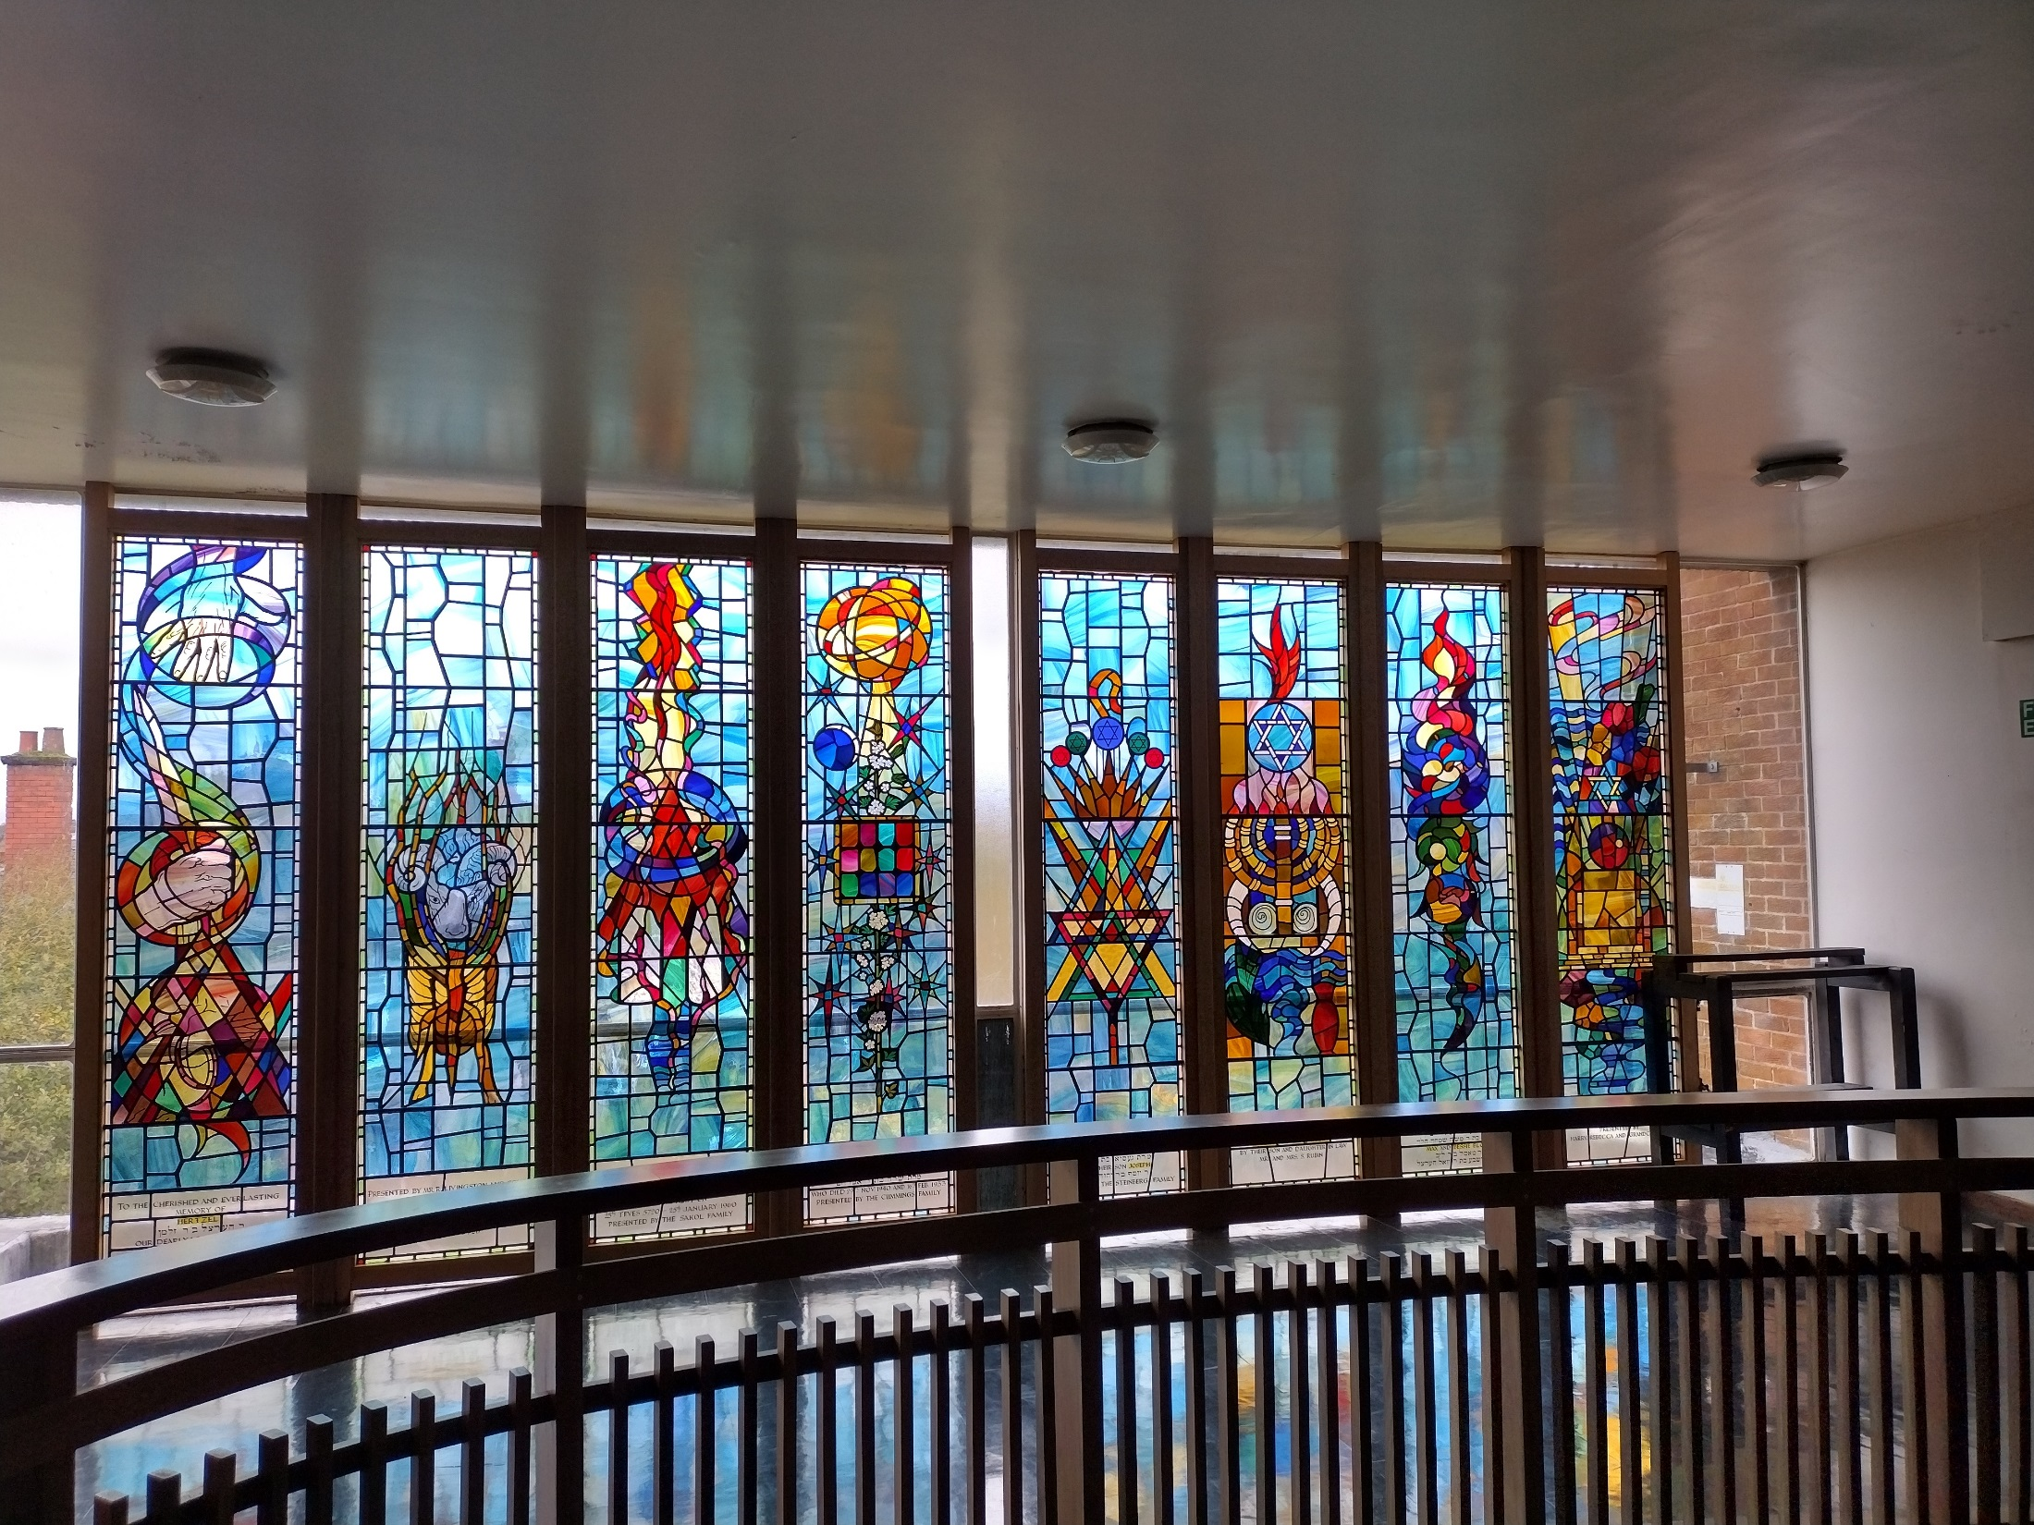

Slide 9
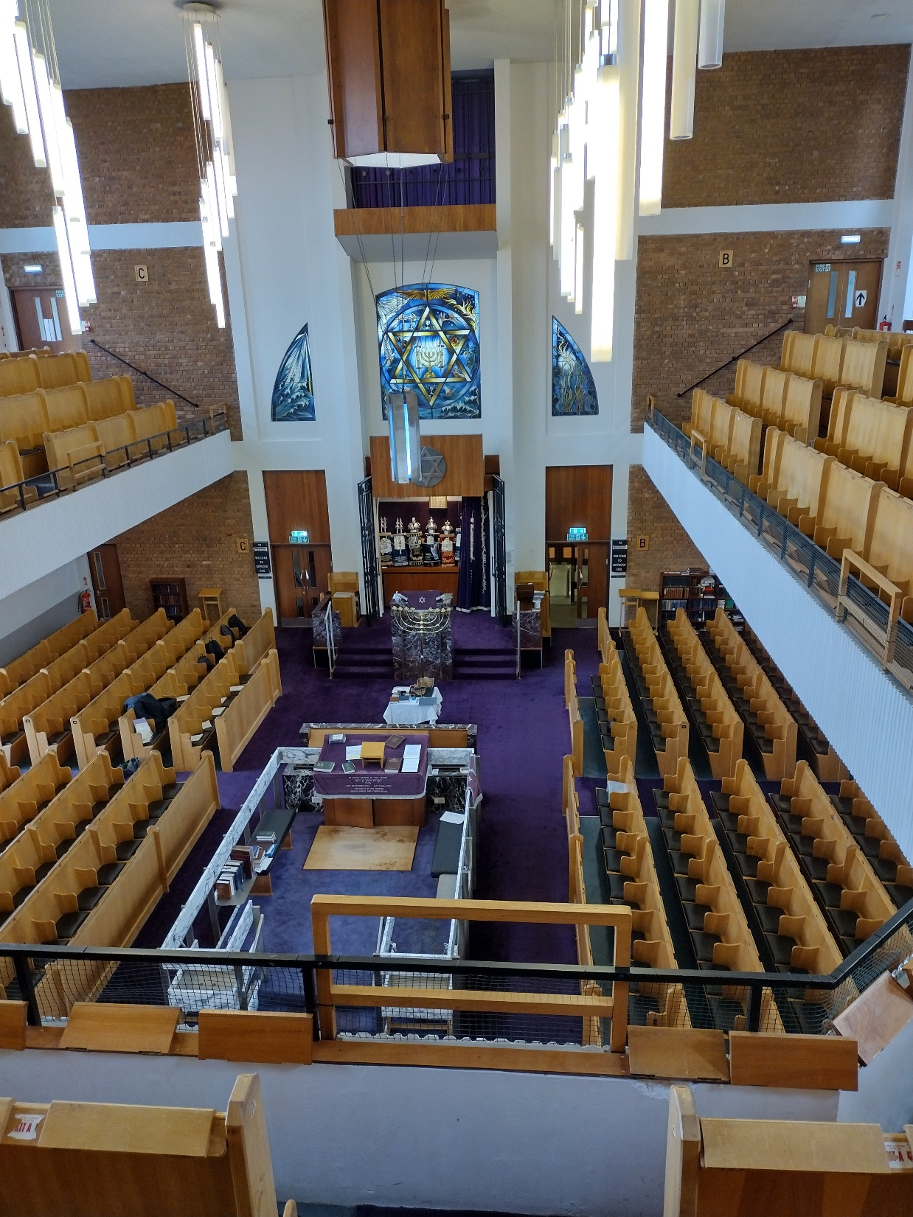

Slide 10
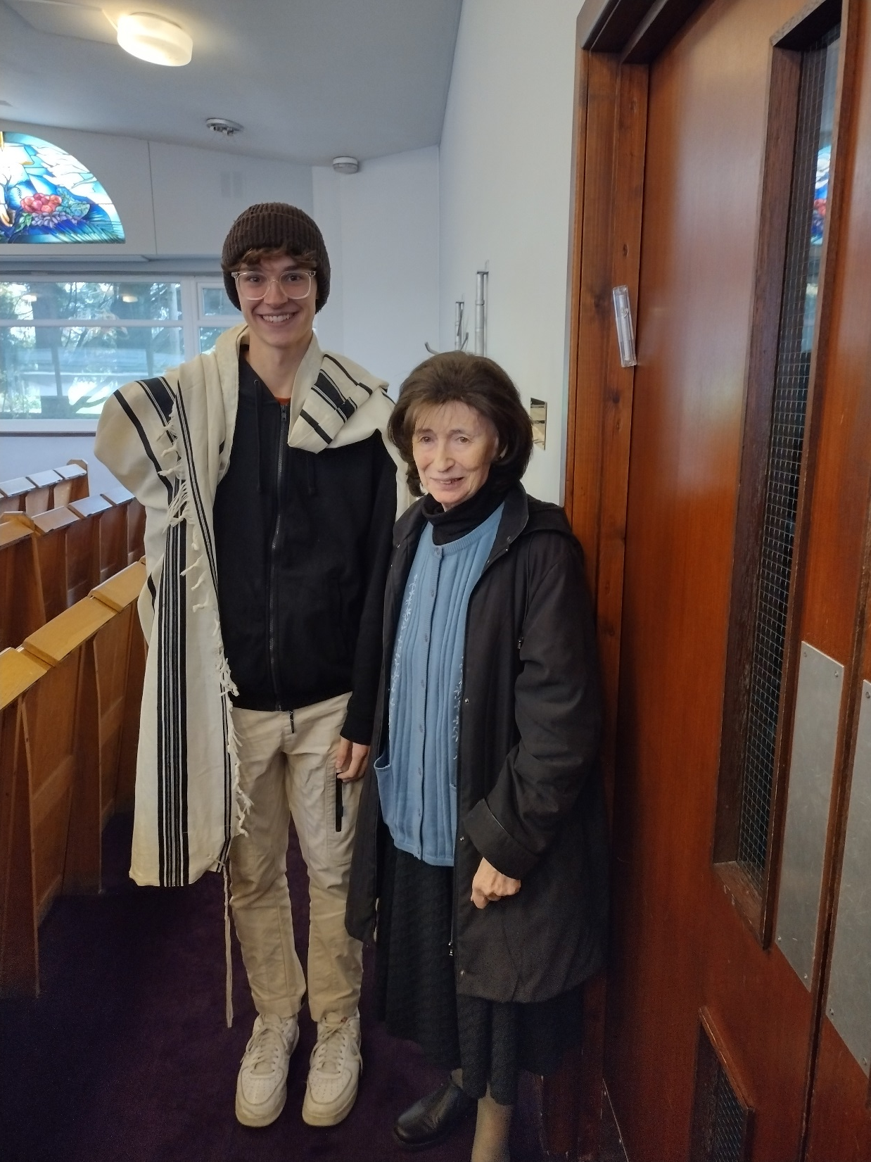

Slide 11
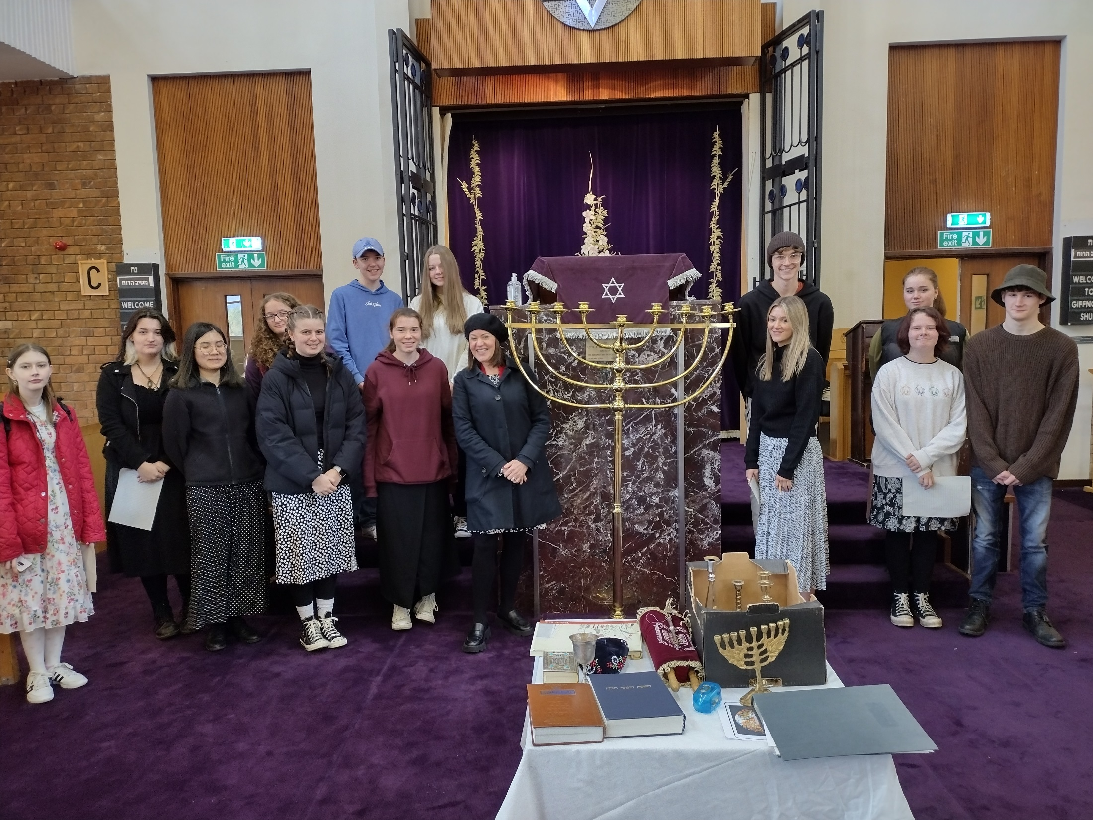

Slide 12


Slide 13
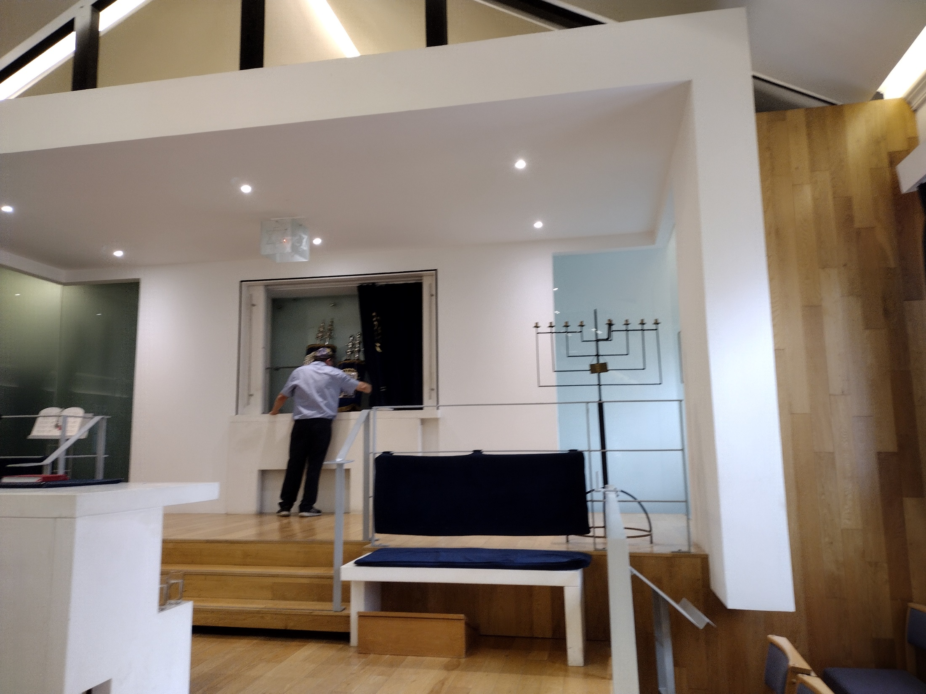

Slide 14
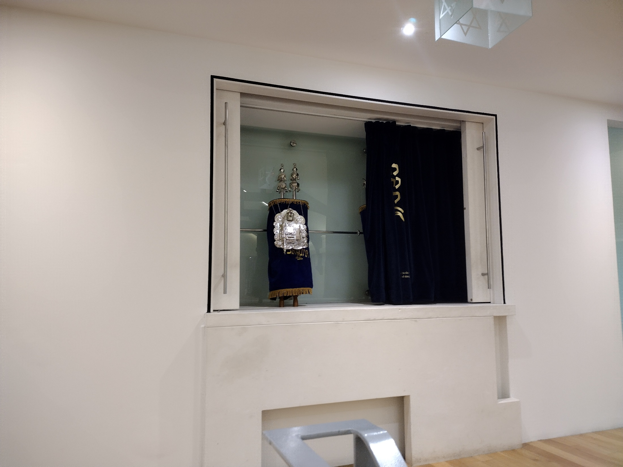

Slide 15
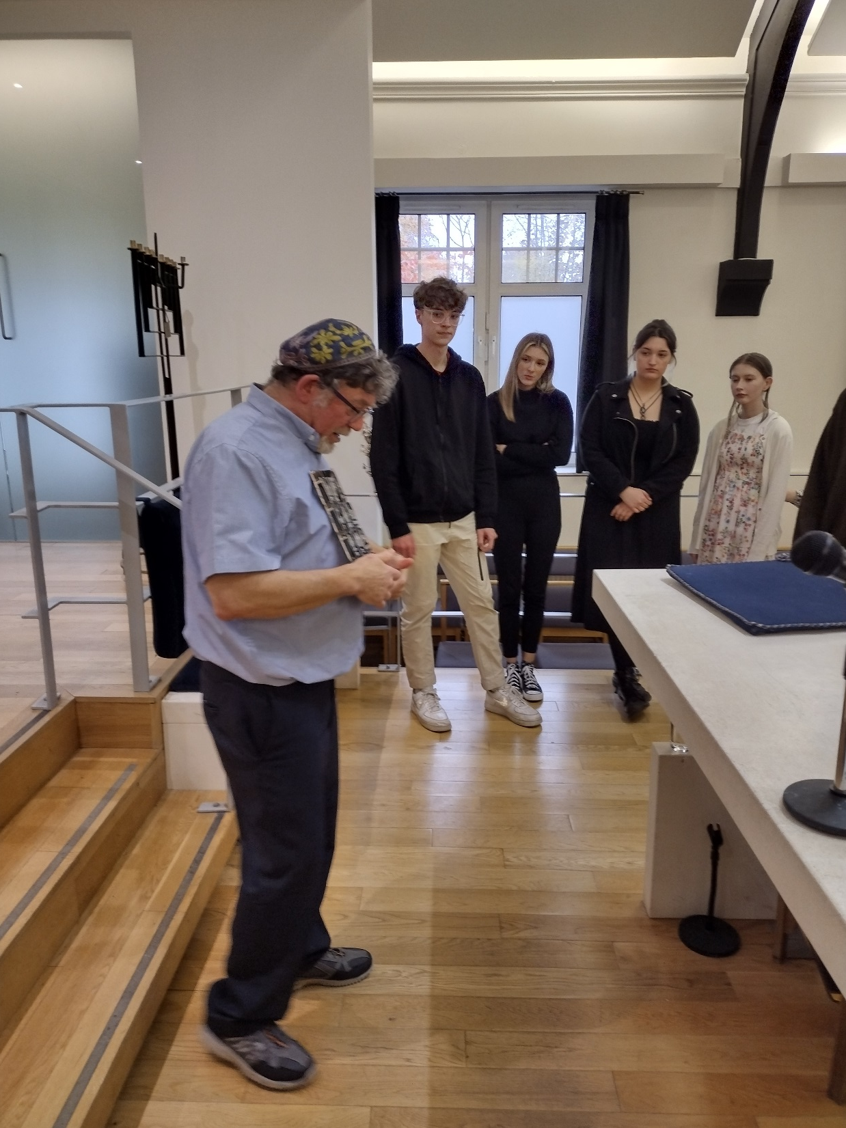

Slide 16
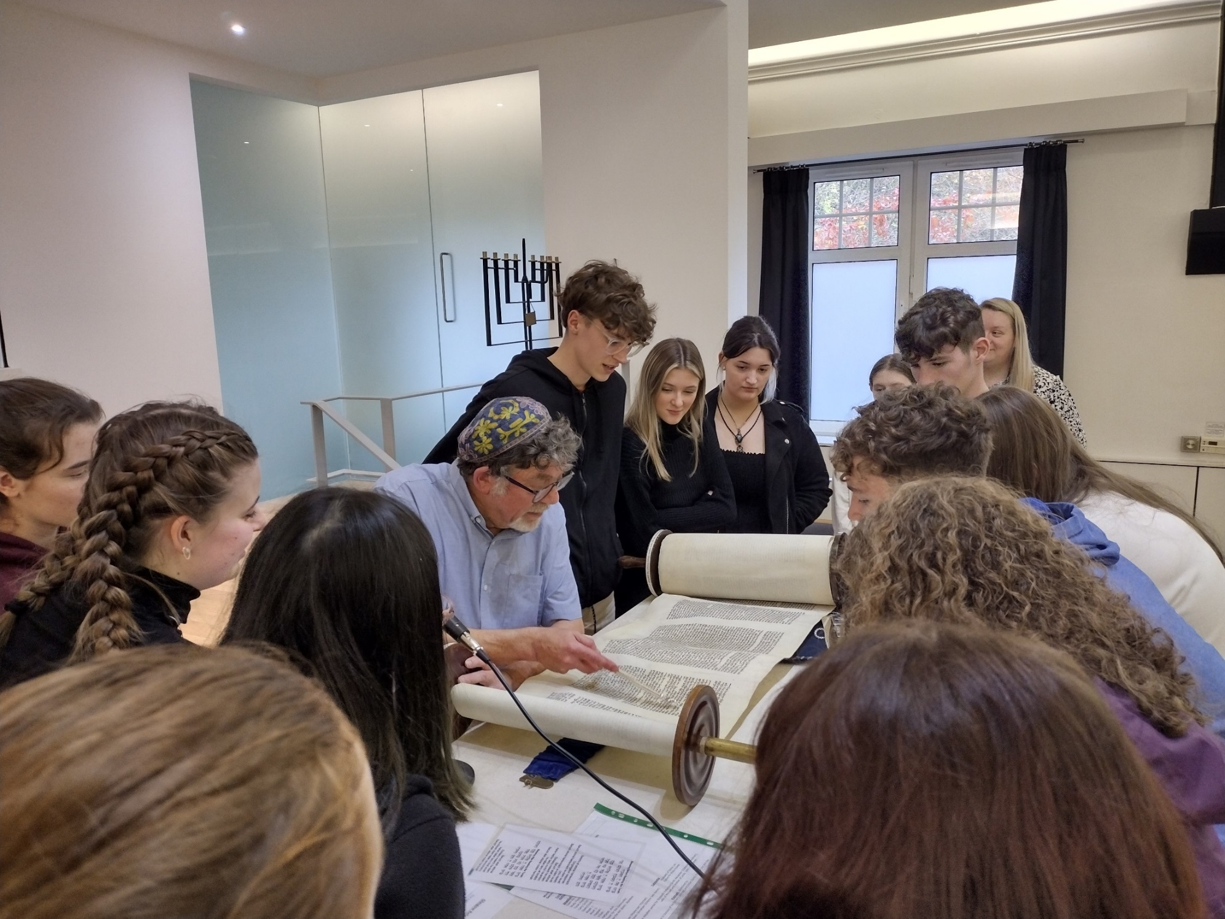

Slide 17
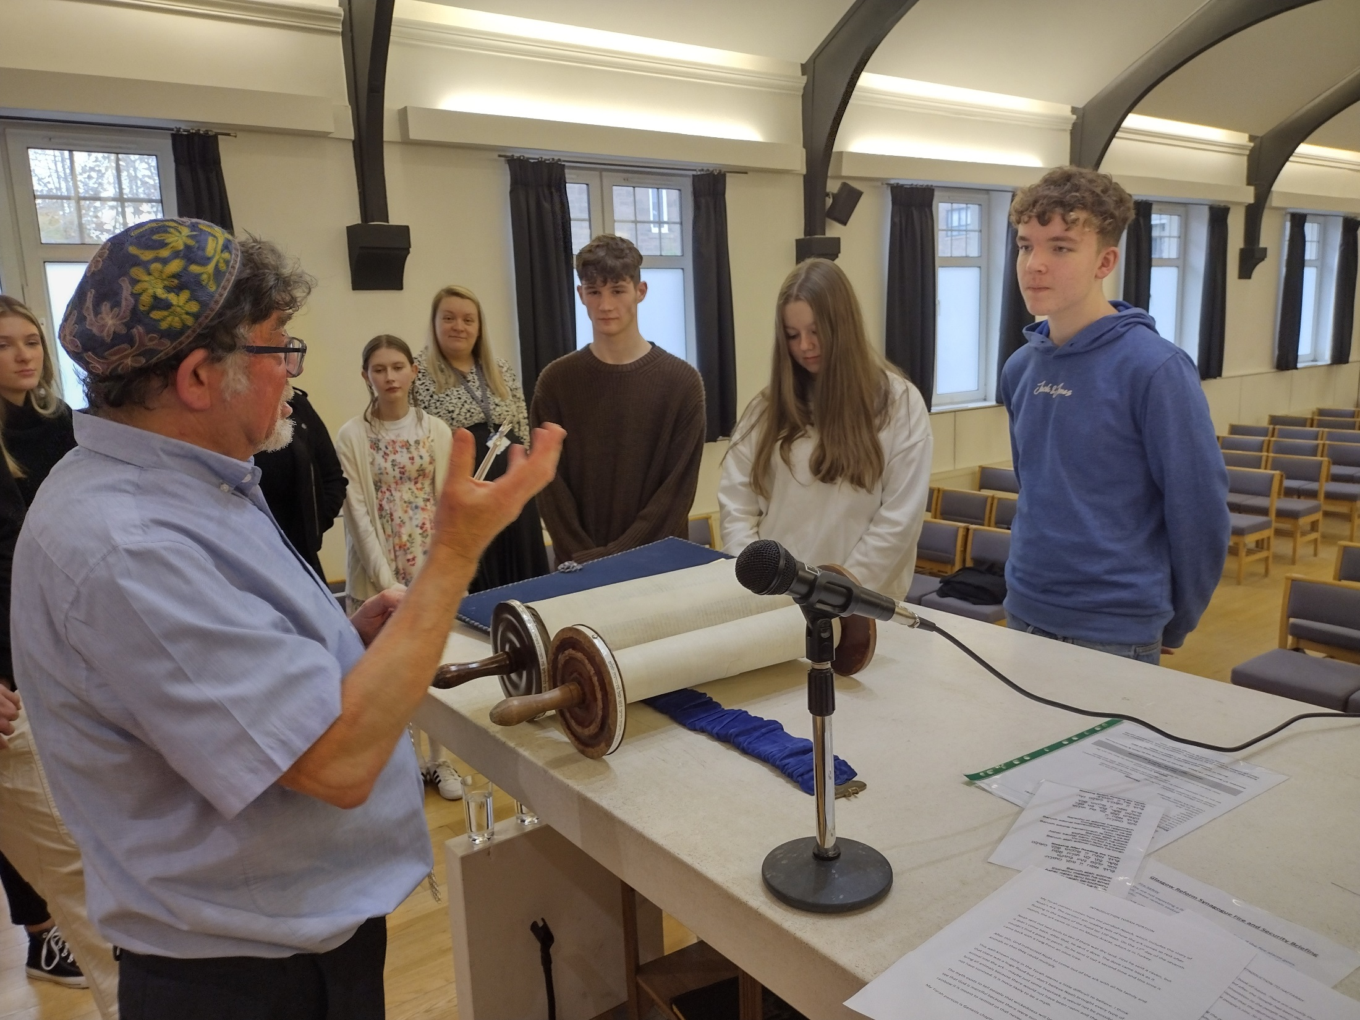

Slide 18
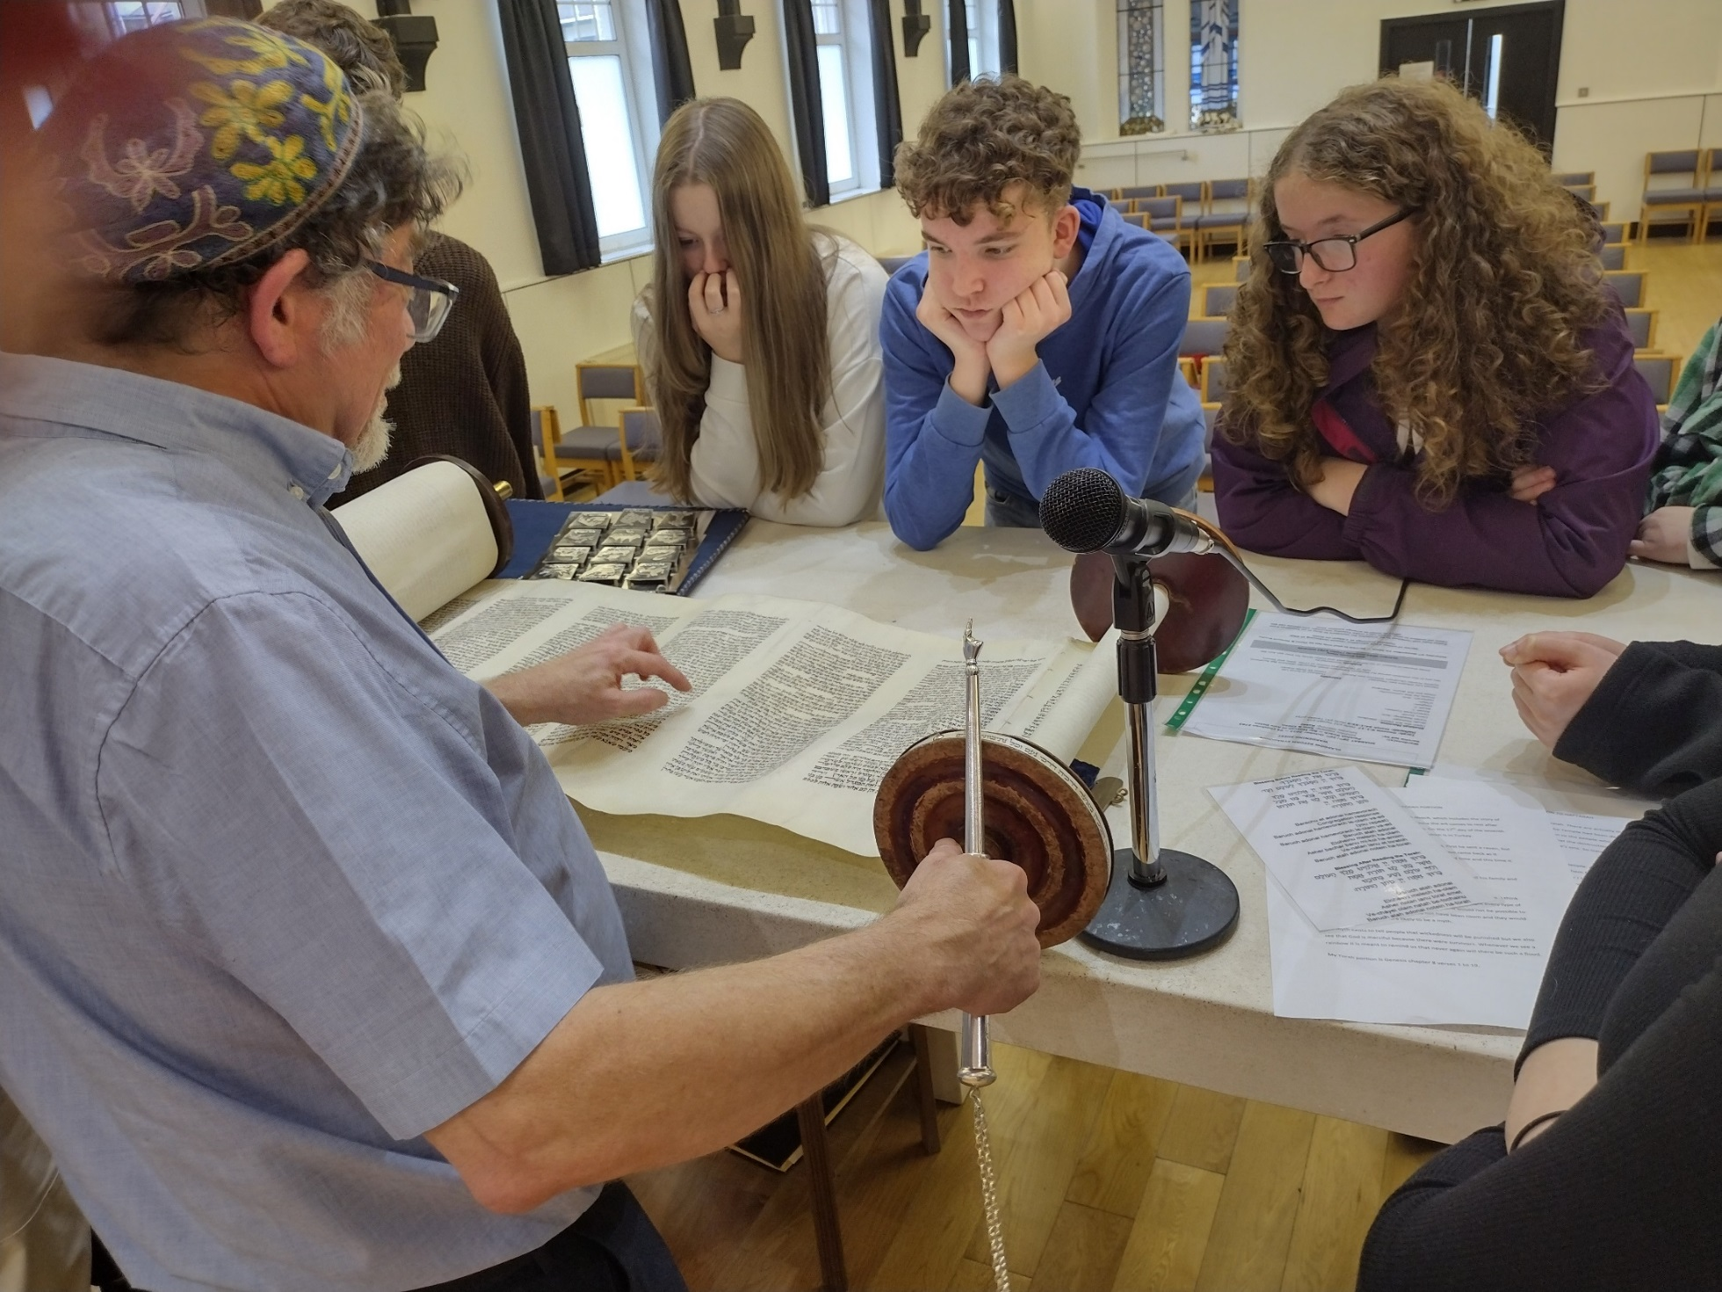

Slide 19
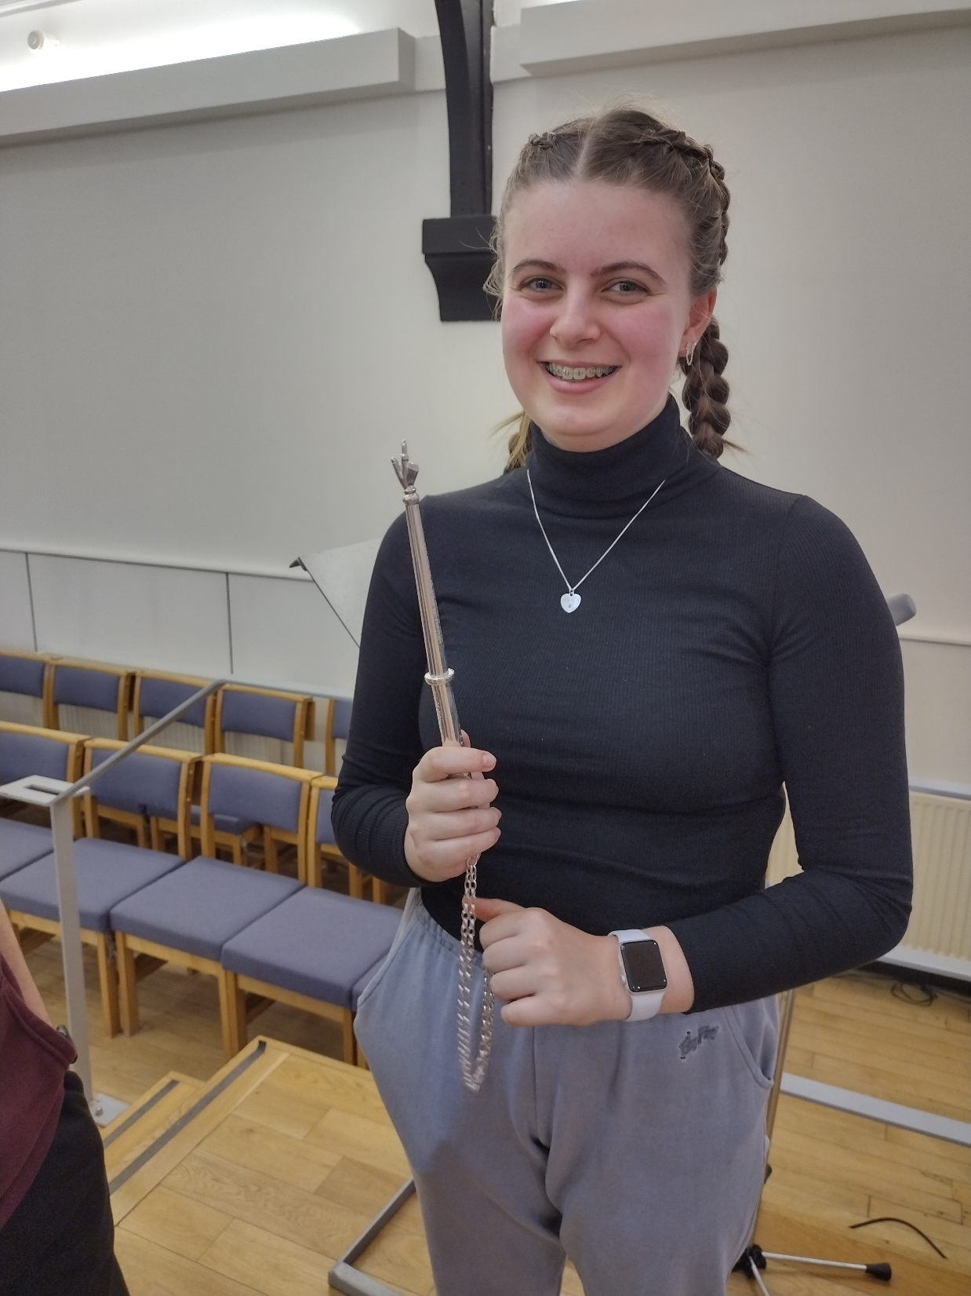

Slide 20
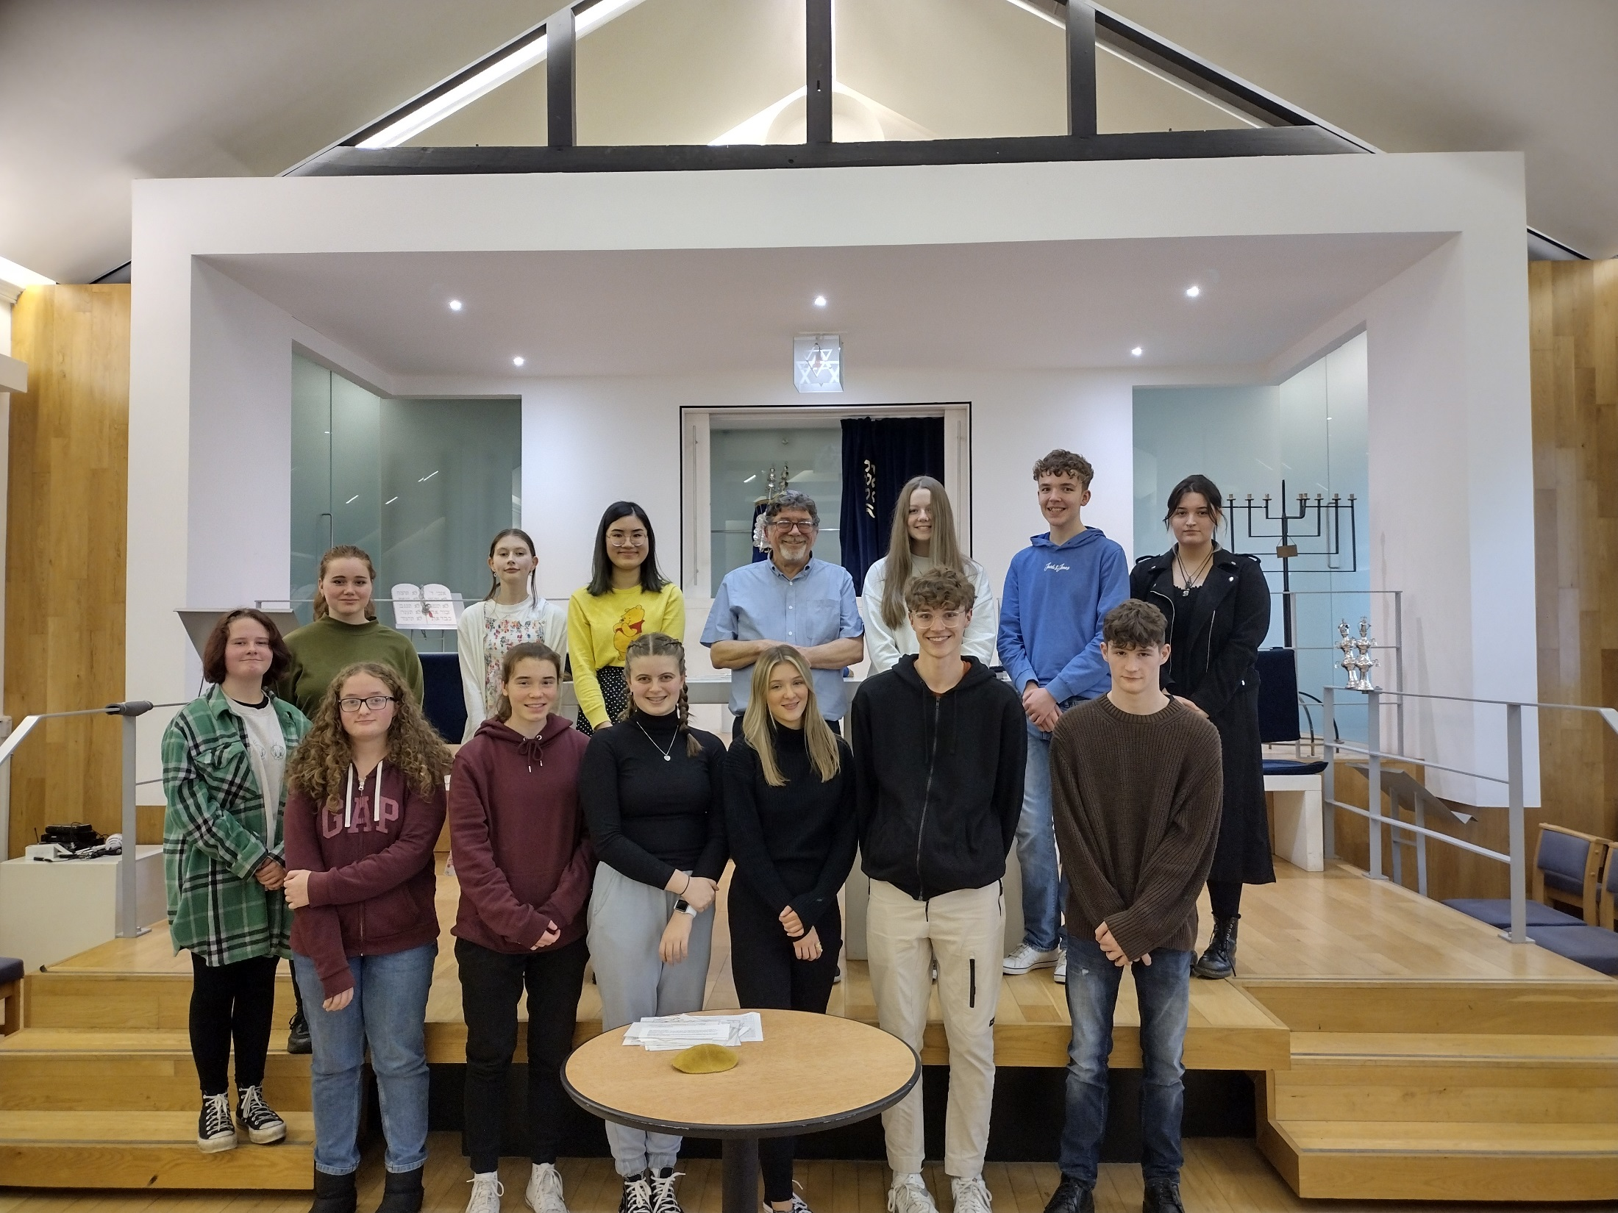

Slide 21
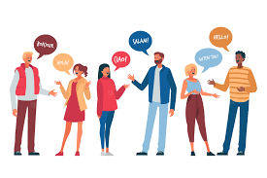
The synagogue visit.
What did we learn?
“ When we visited the two synagogues I learnt…..

Slide 22
Starter task: Quick fire questions
Write down one reason a Jew would pray.
Which book of the Torah contains the Shema?
Fill in the blanks ‘You shall love the Lord your ____ with all your _____ and with all your ______ and with all your __________.’
What is a Mezuzah?

Slide 23
1. Write down one reason a Jew would pray.
They pray to ask God for help and advice.
They pray to show their belief.
They pray to talk to God about whatever is on their heart.
They pray to show they are part of a worshipping community
They pray because the mitzvot tell them too
2. Which book of the Torah contains the Shema?
Deuteronomy
3. Fill in the blanks
‘You shall love the Lord your God with all your heart and with all your soul and with all your might’
4. What is a Mezuzah?
A small object which contains the Shema and is put on every doorway in a Jewish home.

Slide 24
Research task
You are going to research the Synagogue and become an expert about 3 aspects.
Two aspects of the building:
The ark, the torah scrolls, the star of David the Ner Tamid or menorah
One aspect of clothing:
The kippah, the tallit, the tefillin
For each aspect write:
1. A description of what it is.
2. An explanation of its purpose/significance/impact on Jews.
Resources:
Information sheets on GC
Judaism- Living faiths p40-41 and 46-47
Judaism- Modern World Religion p14-17 and 24-25
Google!

Slide 25
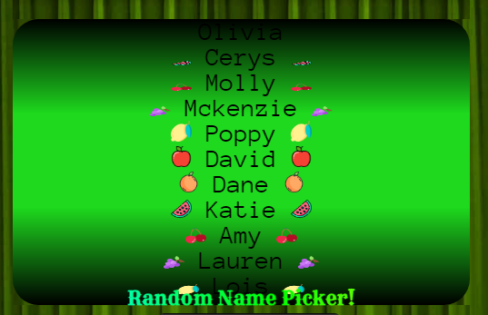
Lets learn from each other
https://www.classtools.net/random-name-picker/89_VjeeWh

Slide 26
Why Jews attend the Synagogue
. To worship God giving him thanks and praise.
. To listen to the Torah.
. To pray and ask God for help.
. To learn more about God’s laws.
. To meet with other believers.

Slide 27
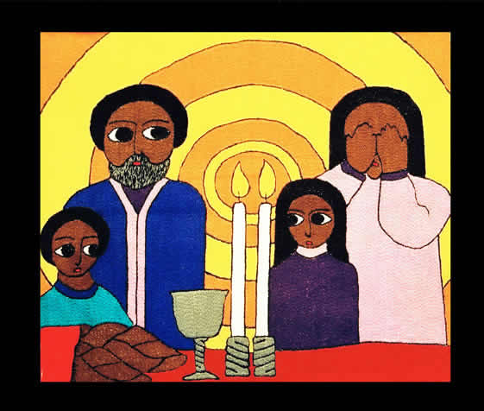
31.10.22 Shabbat
Shabbat occurs between sunset on Friday and sunset on Saturday.
No work should be done during this time.
It is observed by the majority of Jewish people every week.

Slide 28
Friday before sunset
The food is already prepared.
The house will be clean
and sparkling.
The table is laid with the best
tablecloth and cutlery.
Candles are ready to be
lit.
Two loaves of bread called
Challah are placed on the table covered
with a special cloth.

Slide 29
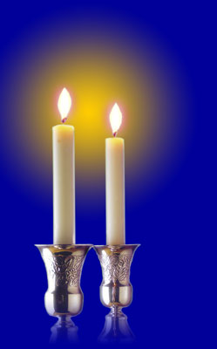
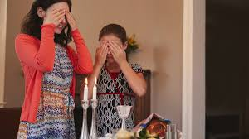
Lighting the candles
“Blessed are you, Lord our God, King of the Universe. You sanctify us with your commandments, and you command us to light the candles for Shabbat.”
Just before Shabbat begins, which in no later than 18 minutes after sunset, the mother of the house lights the candles and, covering her eyes, says the blessing:

Slide 30
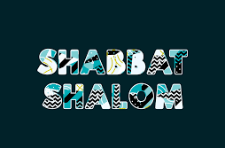
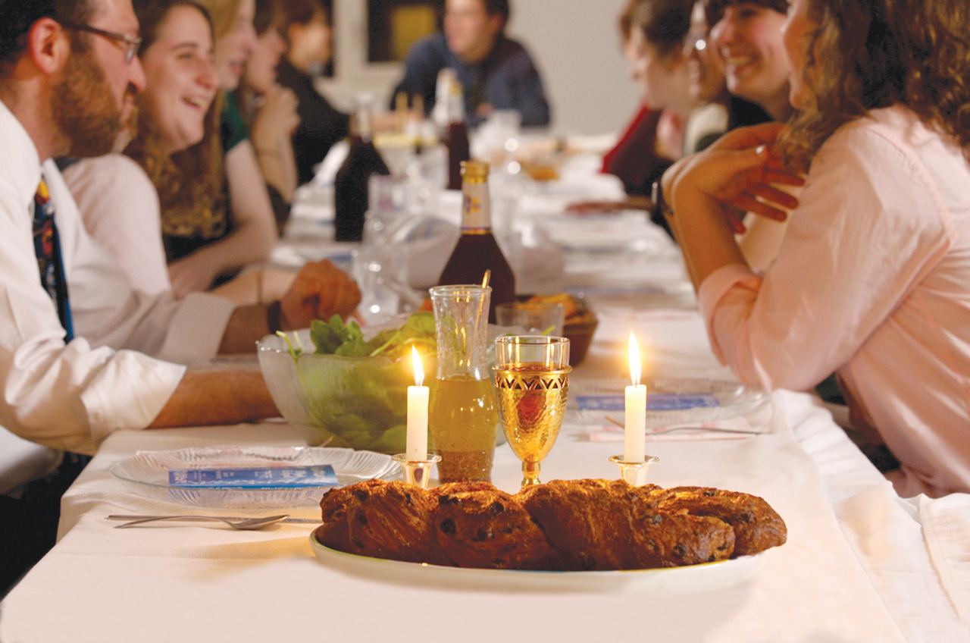
After candle lighting, everybody uncovers their eyes and says:
Which means “have a peaceful Shabbat”
They then sit down, sometimes songs are sung.
https://www.bing.com/videos/search?q=shabbat+shalom&view=detail&mid=852035D25BF5480C0C9A852035D25BF5480C0C9A&FORM=VIRE&ru=%2fsearch%3fq%3dshabbat%2bshalom%26src%3dIE-SearchBox%26FORM%3dIENAD2

Slide 31
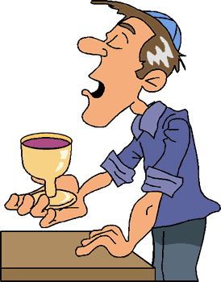
KIDDUSH IS A HEBREW WORD THAT
MEANS ‘SANCTIFICATION’ OR ‘MAKING
HOLY’
The Kiddush
The Father of the house fills a cup called the Kiddush cup with wine.
He lifts the cup and says an ancient prayer of blessing called the Kiddush.

Slide 32
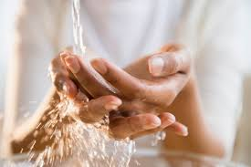
Hands are then washed, away from the table, in silence.

Slide 33
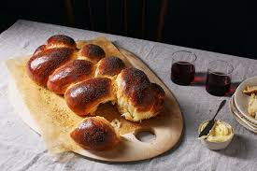
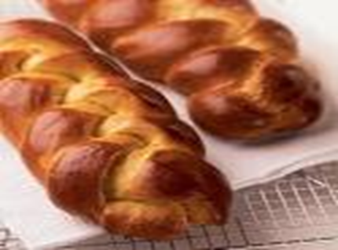
Then silence until the bread is eaten.
There are two Challah loaves.
It is blessed, then cut and sprinkled with salt and shared with everyone.

Slide 34
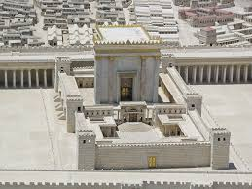
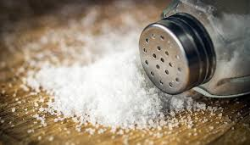
The challah is spinkled with salt or dipped into salt to commemorate the sacrifices offered in the Temple in Jerusalem, which always contained salt.
Although the Temple no longer stands, the salt reminds Jews of their history.
With every offering brought to the Temple, a salt offering was also prepared (Leviticus 2:13: And you will season every meal-offering with salt; neither shall you suffer the salt of the covenant of your God to be lacking from your meal-offering; with all your offerings you shall offer salt.)
This reminds Jews of the eternal covenant with God, which, like salt, never spoils.

Slide 35
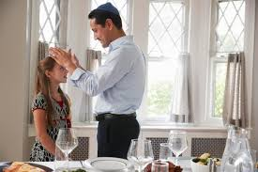
Families bless their children one by one.

Slide 36
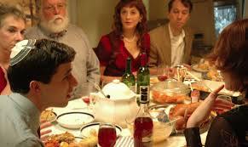
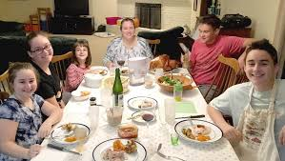
Then the meal can begin.
There is normally three courses of Kosher food and lots of chat and laughter.

Slide 37
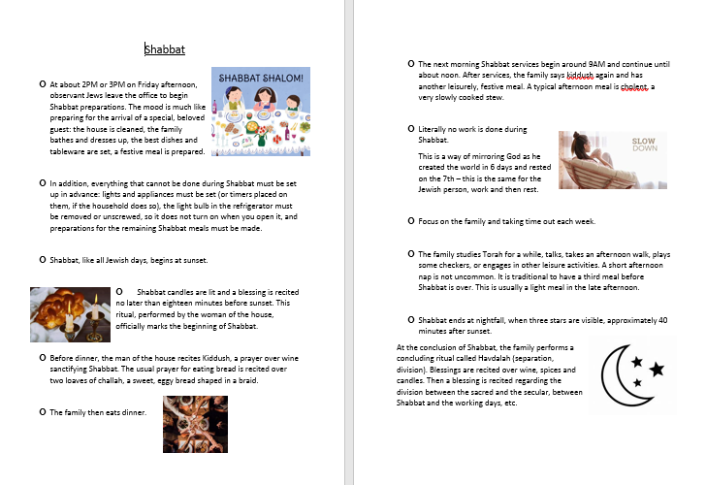
Read through the worksheet and add at least 3 points to your notes.

Slide 38
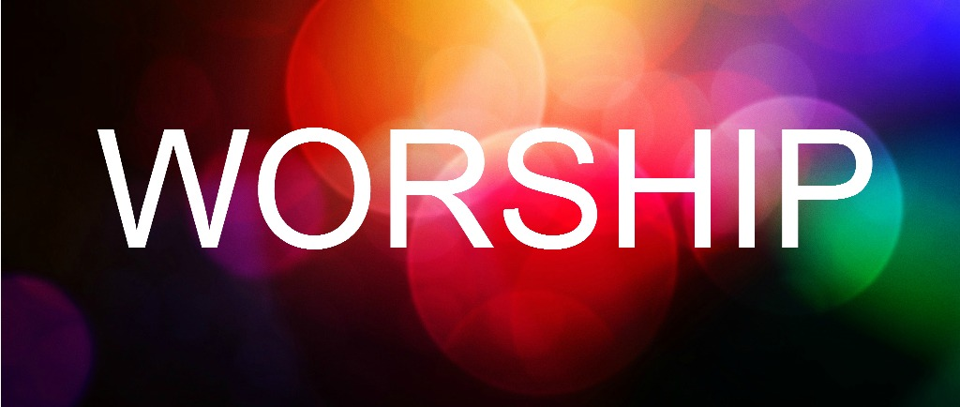
How?
Worship = To give something worth.
To show adoration to something.
Why?

Slide 39
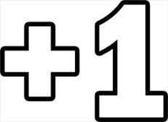
PLUS ONE
The following question is worth FOUR MARKS
Write down 1 POINT worth 1 MARK.
Then, PASS YOUR JOTTER to someone else.
You should now have SOMEONE ELSE’S jotter in front of you – WRITE DOWN ANOTHER POINT in this jotter
THEN, PASS IT ALONG AGAIN.
REPEAT until you have written down 4 POINTS and have your OWN JOTTER BACK!
*You may DEVELOP a point made by someone else if you believe it will gain another mark, or simply write a NEW point underneath.
* You MUST write something different from what has already been written by your peers!
‘What is the purpose of worship?’
Think about what you learnt from our study of the Synagogue and Shabbat

Slide 40
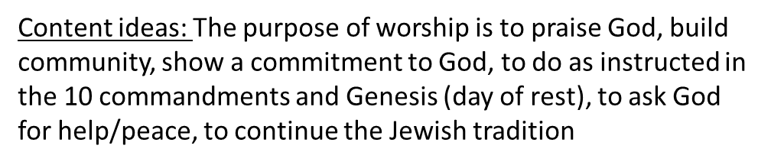

Slide 41
Worship: Shabbat:
“You must observe my Sabbath.” Leviticus 19:3
“Six days you shall work, and the seventh day is Shabbat, for the Lord your God.” Deut 5:13
Synagogue
“There in the presence of God you must worship God and rejoice in everything he has given you.” Deut 12:7
“If you seek the Lord you will find him if you seek him with all your heart.” Deut 4:29
Lets see where these ideas are shown in the Torah.

Slide 42
Lets try some analysis.
Choose one of the quotes and explain how it makes your point.
Here is an example:
One purpose of worship is to continue the Jewish tradition. In the book of Leviticus it says “You must observe my Sabbath.” This verse shows that worshipping God on the Sabbath it an essential part of being a Jew and therefore something all Jews have always done. Therefore Jews will rest on Shabbat from sunset on a Friday to sunset on Saturday, and attend the Synagogue to keep the tradition of their ancestors alive.

